Slide 1
Cathodes to Concentrate:
The changing face of Straits, and the evolution of exploration within the Girilambone Group.
Mines and Wines Conference 2015
Chris Raymond

Slide 2
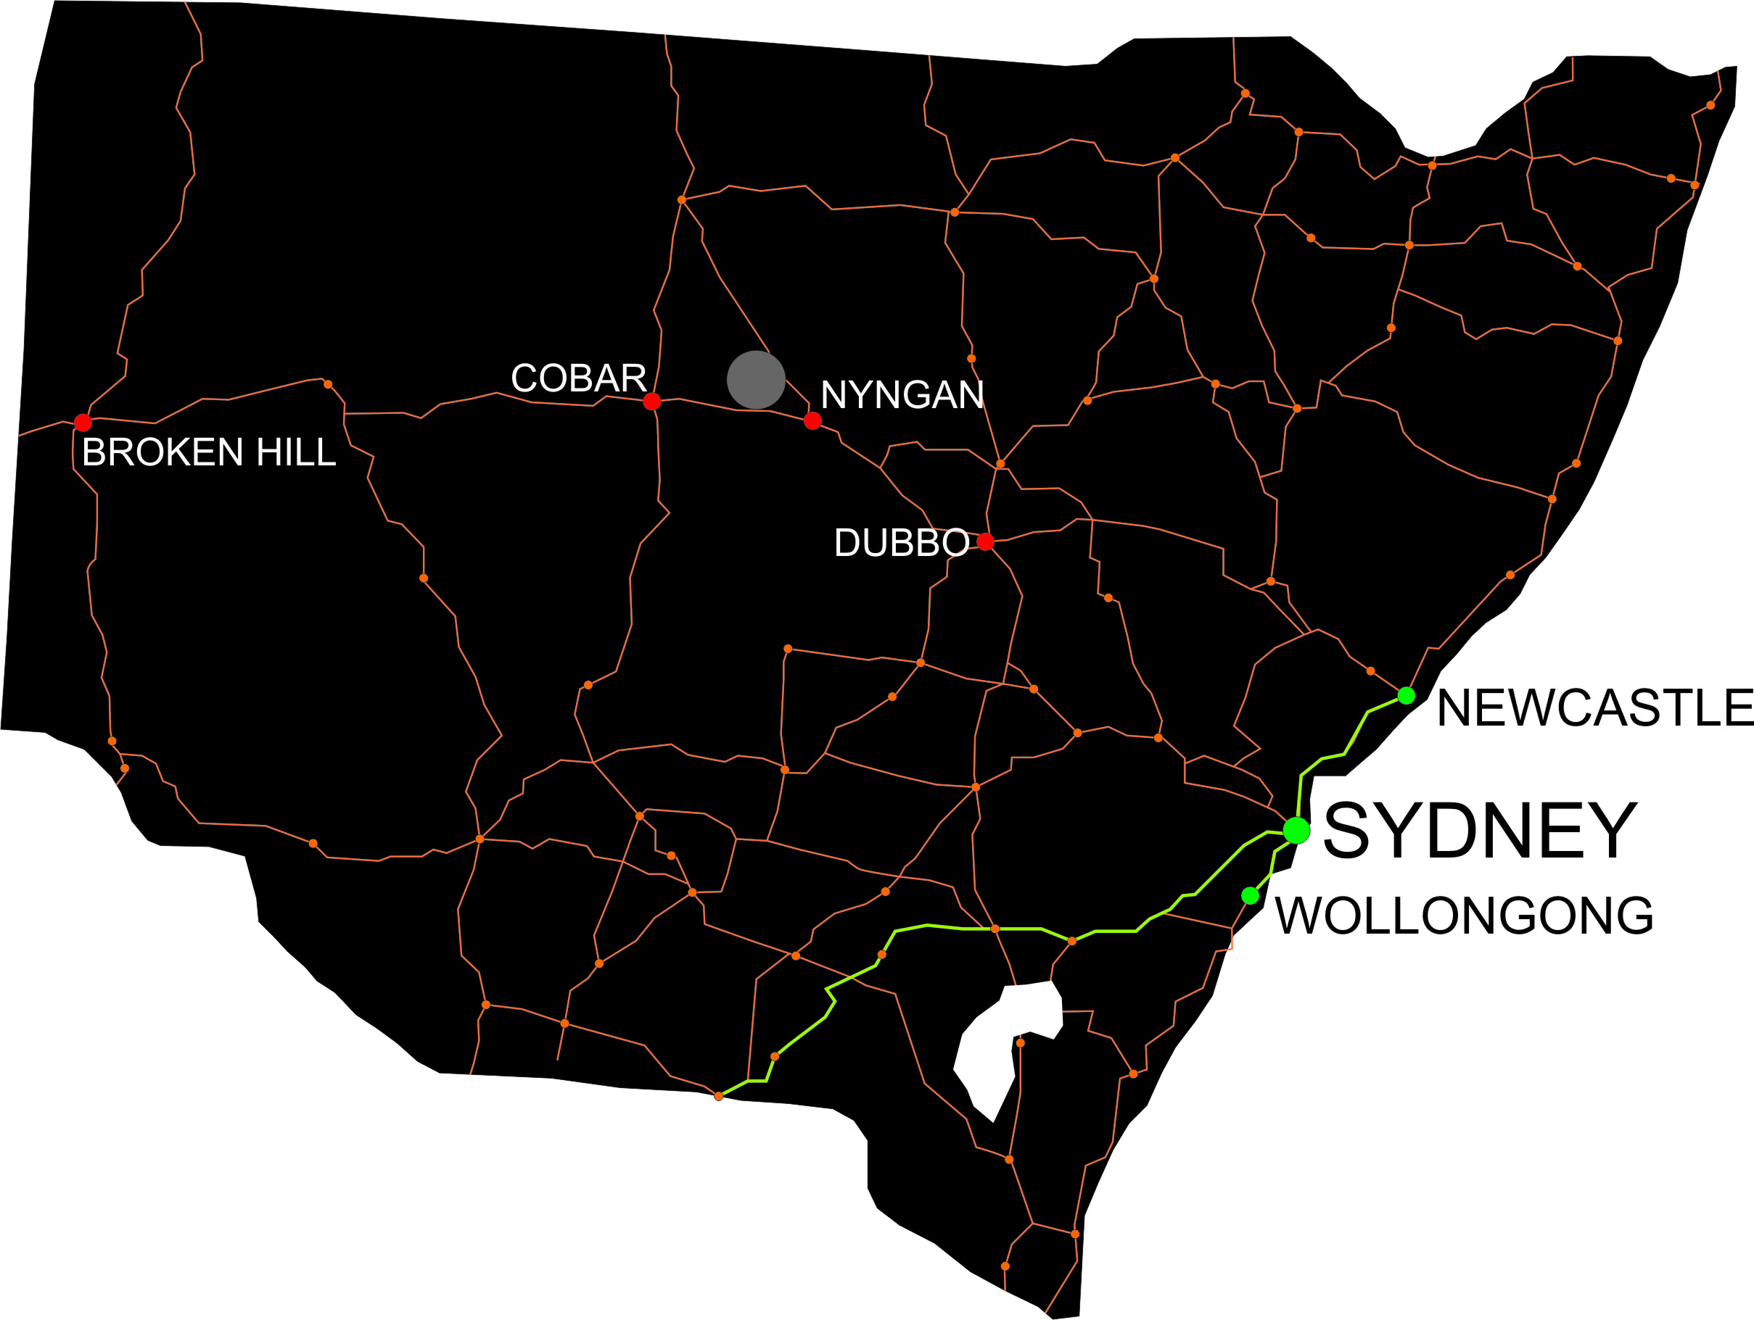
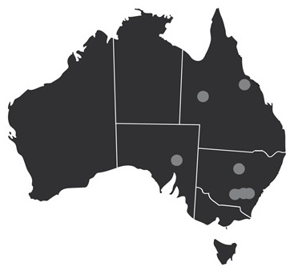
Location
Exploration Portfolio

Slide 3
Discovery History
1875 - Thomas Hartman & Charles Campbell claim discovery of Cu @ Girilambone
1881 - The Richardson family successfully dispute the claim, and start mining as the Girilambone Copper Mining Co Ltd.
- Copper and Gold discovery at
Budgery.
- Nord Resources (Pacific) Ltd, defined a resource of 8Mt @ 1.4% Cu (leachable)
- The Girilambone Copper Company formed via JV (Mining - 60% Straits, 40% Nord, Expl – 50 /50)
1995 - Tritton sulphide Discovery
- Acquisition of whole project by Straits, subsequently float Tritton Resources Limited
- SXEW production ceases
- A Copper Concentrator was
commissioned to process ore from the Tritton Sulphide Deposit.
2011 - North East Offset at depth Discovery
2011 - Avoca Tank Discovery
- Re-acquisition of TRL by Straits
Resources Limited.
2015 - Larsen’s Offset at depth Discovery

Slide 4
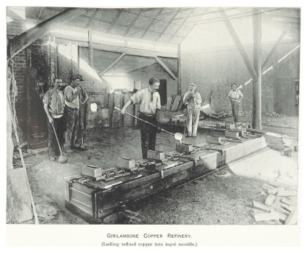
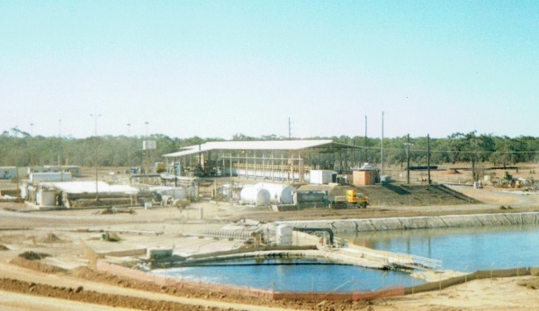
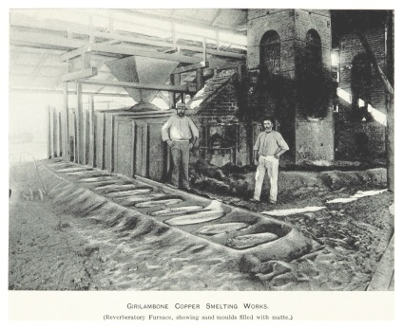
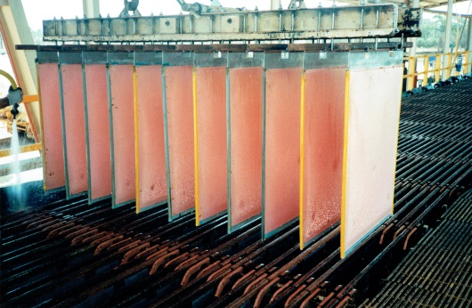
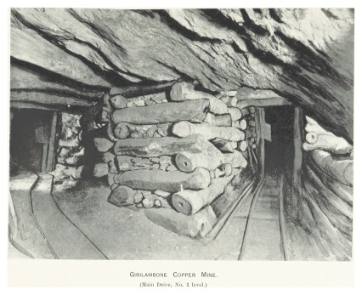
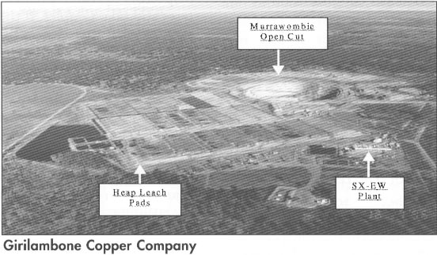
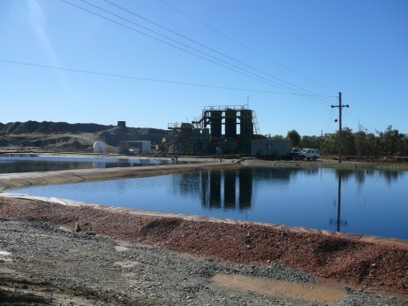
Girilambone Copper Mine
Historic Mining GCM
Heap Leach Pad with GCC feeding an SX-EW plant to produce cathodes
Heap Leach Pads currently feeding a cementation plant.

Slide 5
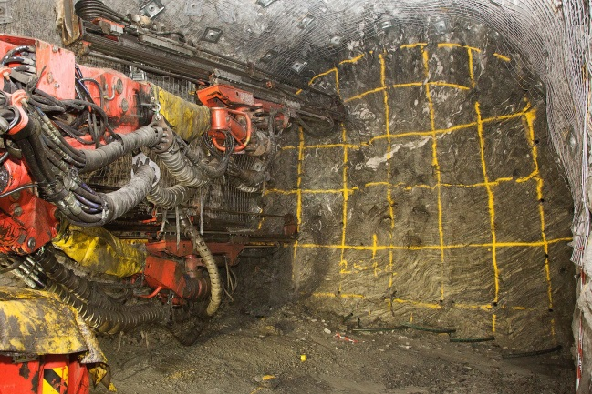
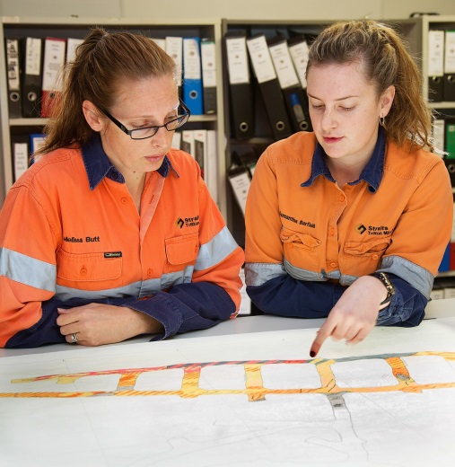
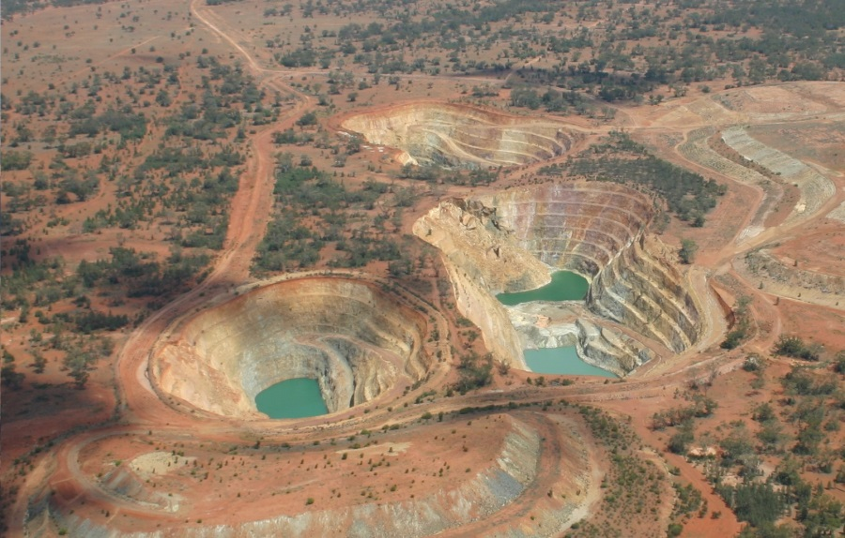
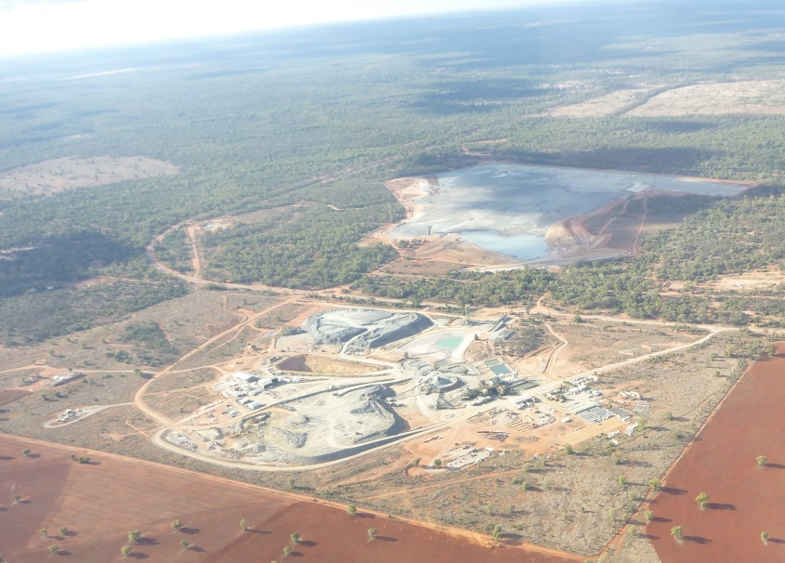
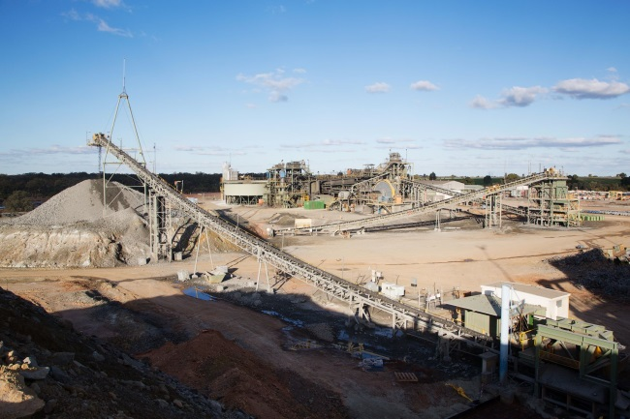
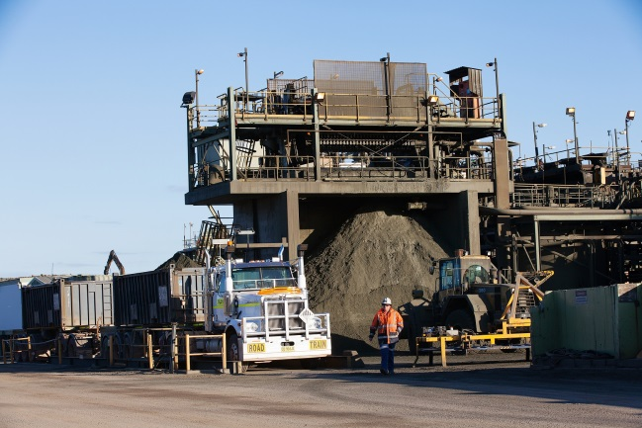
Straits Tritton Mines
Larsens and North East mines
Mining chalcopyrite dominant ore from two underground mines
One central copper concentrator
Tritton mine & copper concentrator

Slide 6
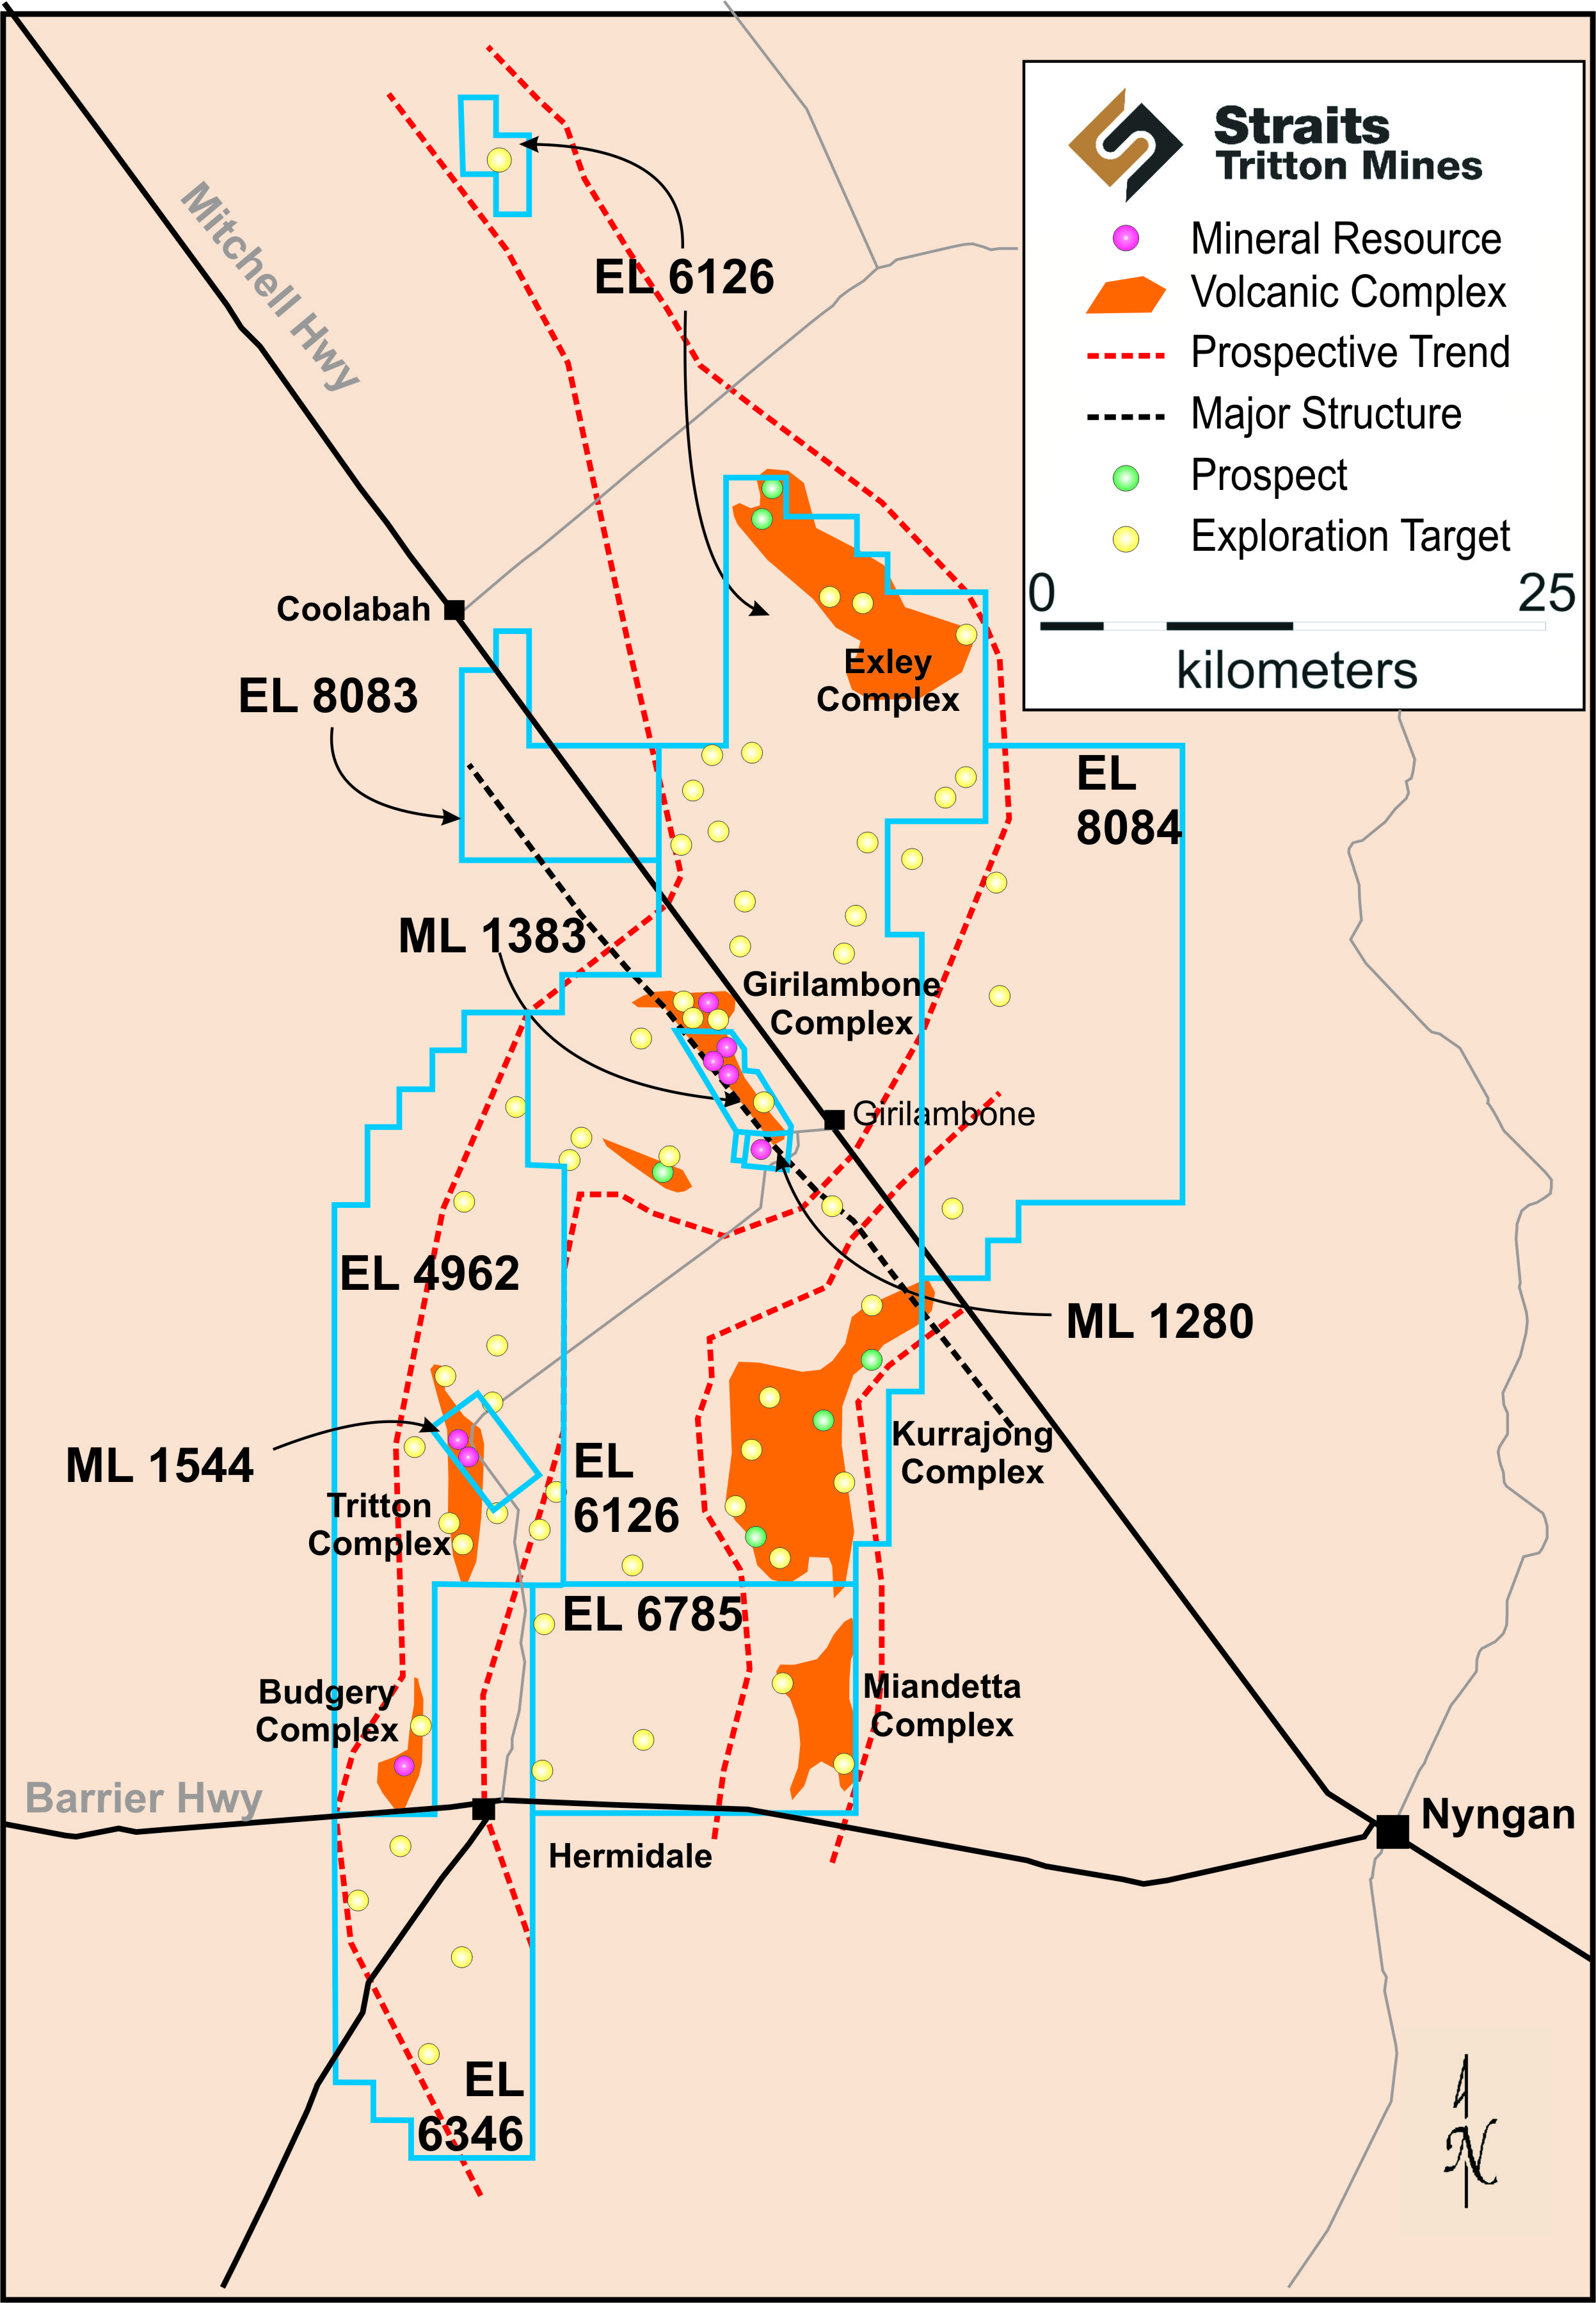
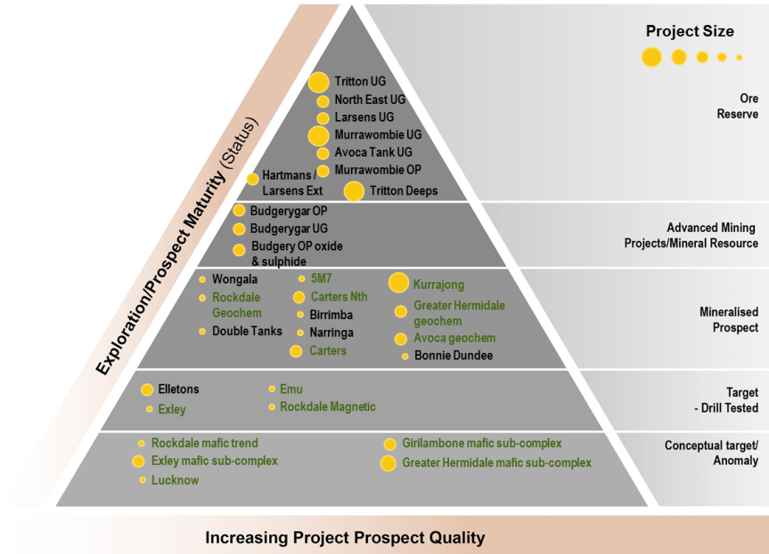
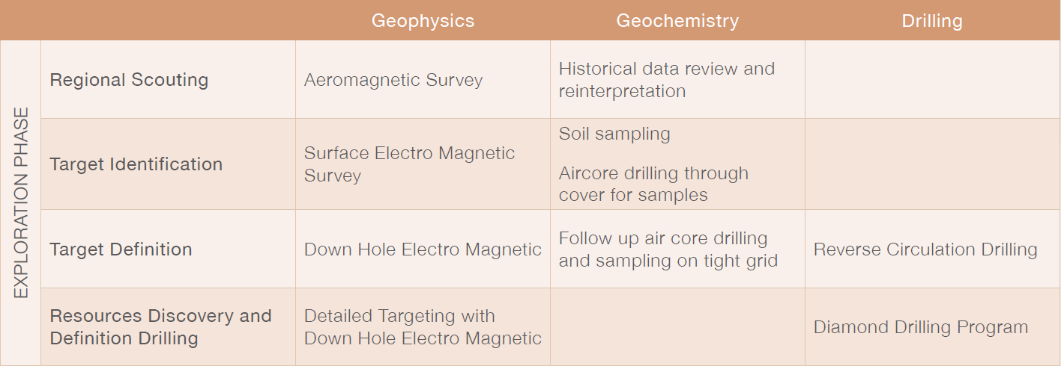
Regional Geology and Strategy
Exploration progresses through systematic investigation of targets, via methodology below, and juxtaposed with other prospects, on the diagram above.

Slide 7
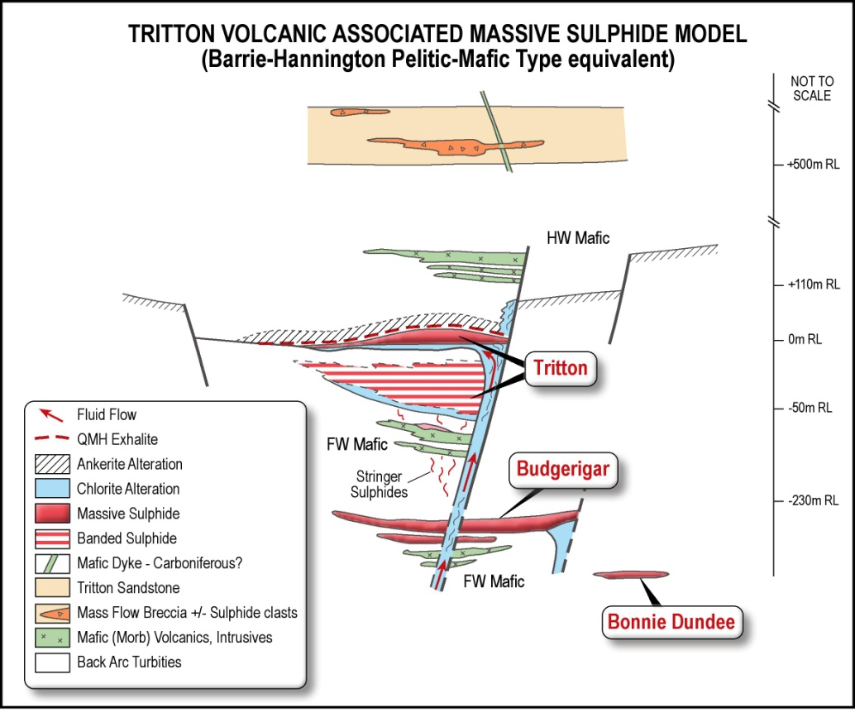
Besshi VAMS Model
Besshi Style Mineralised Systems Globally:
Soucy (Canada) 4.3Mt @ 1.4% Cu
Besshi (Japan) 30Mt @ 2.5% Cu
Brittania (Canada) 48Mt @ 1.9% Cu
Ducktown (USA) 163Mt @ 1.0% Cu
Windy Craggy (Canada) 198Mt @ 1.8% Cu
Straits Tritton Mines
(Australia) 46Mt @ 1.7%Cu
Tritton is certainly a world class Besshi mineralised system with huge potential for further discovery.

Slide 8
Understanding Geology
Geochemistry
Geophysics
Drilling

Slide 9
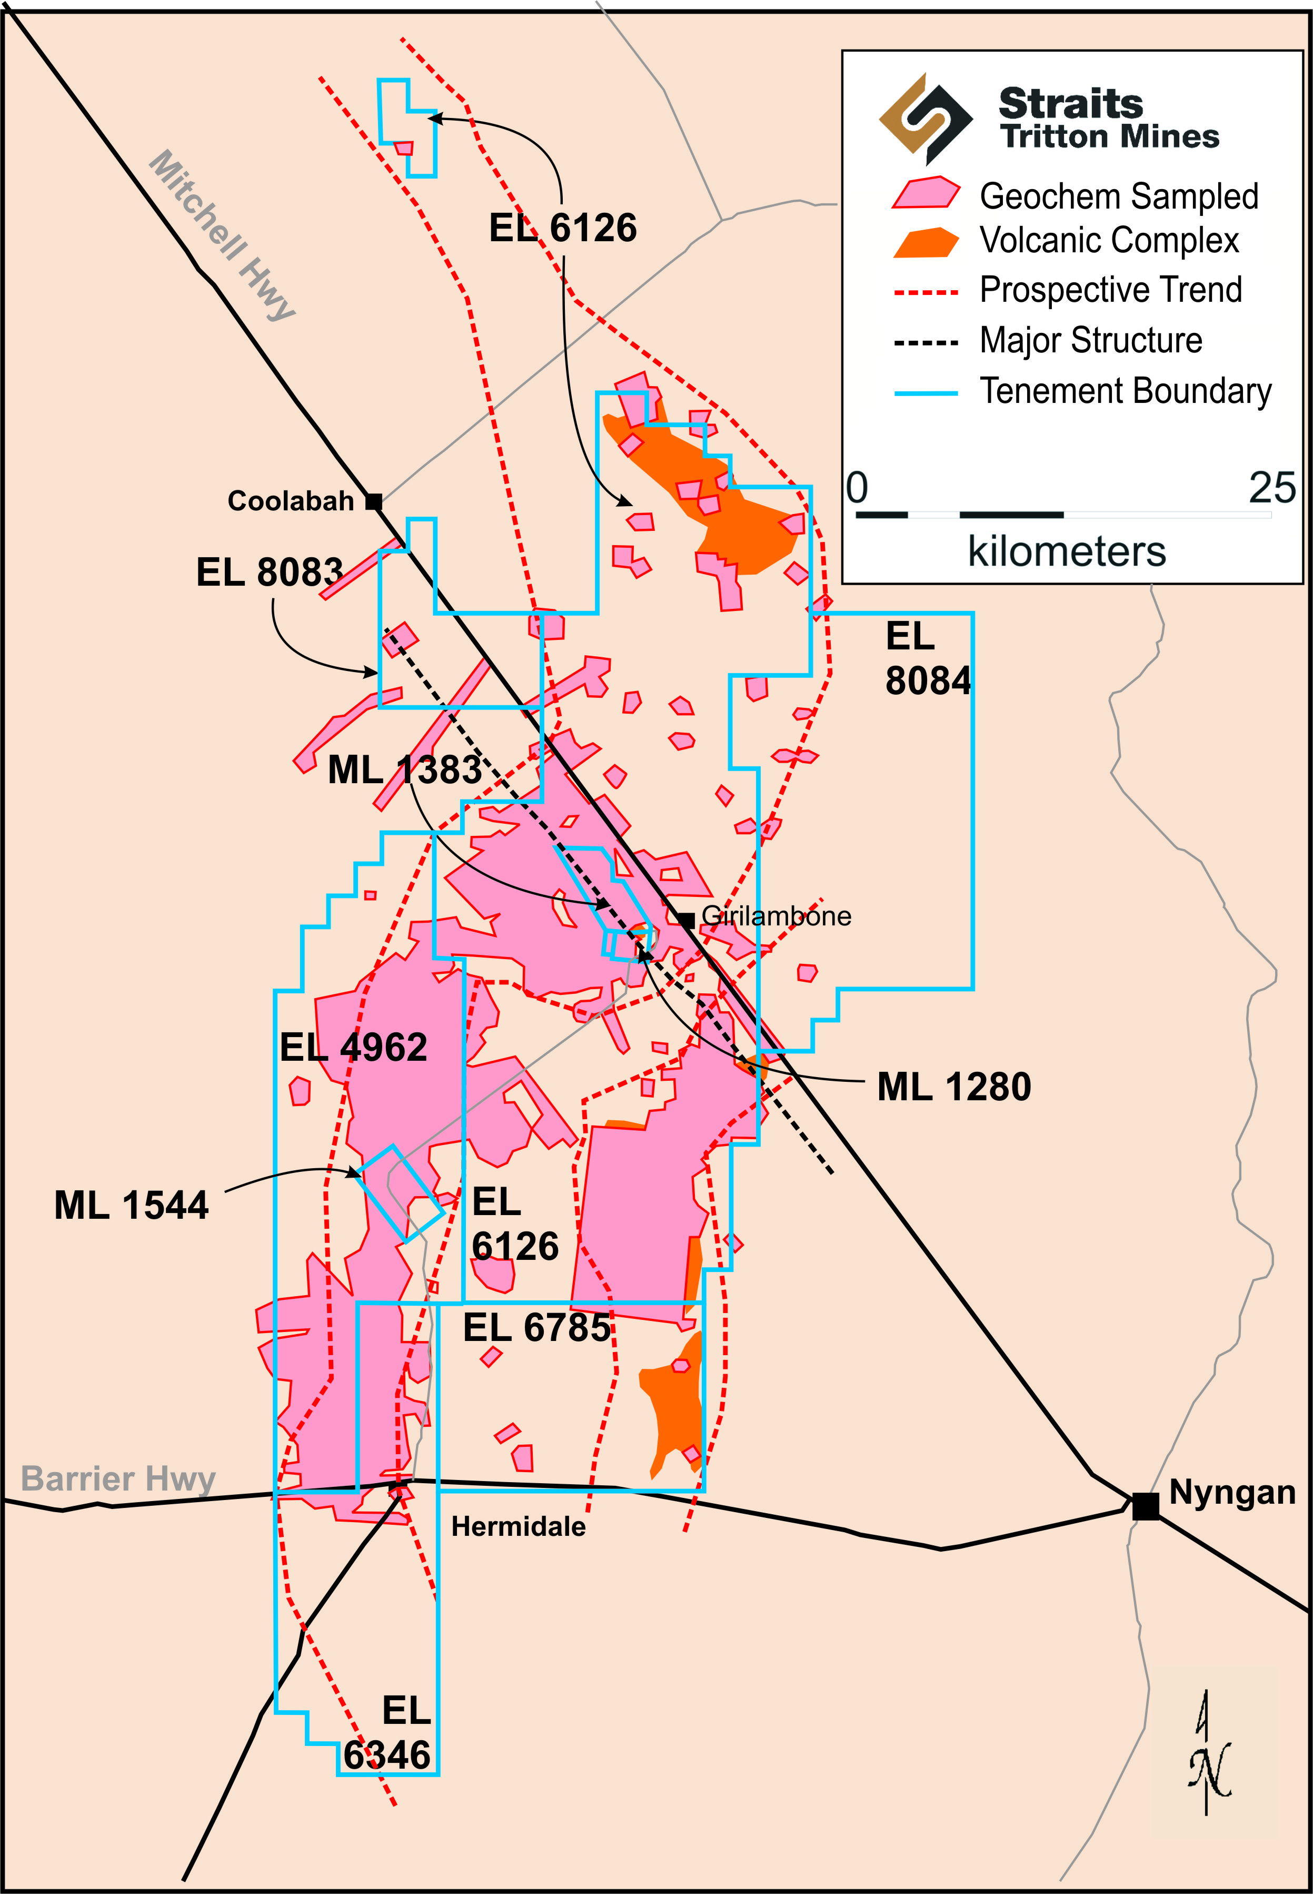
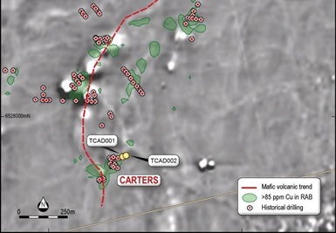
Soil Geochemistry
Hugely important however predominantly completed previously. Current work does include:
Validation of data
Resampling for additional elements
Infill sampling
Sampling previously un-sampled areas.
80ppm Cu leveled data shows all of the current deposits, and highlights many areas previously untested.
80ppm Cu anomalism near the Carters prospect.

Slide 10
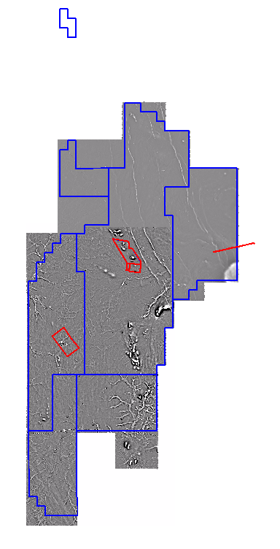
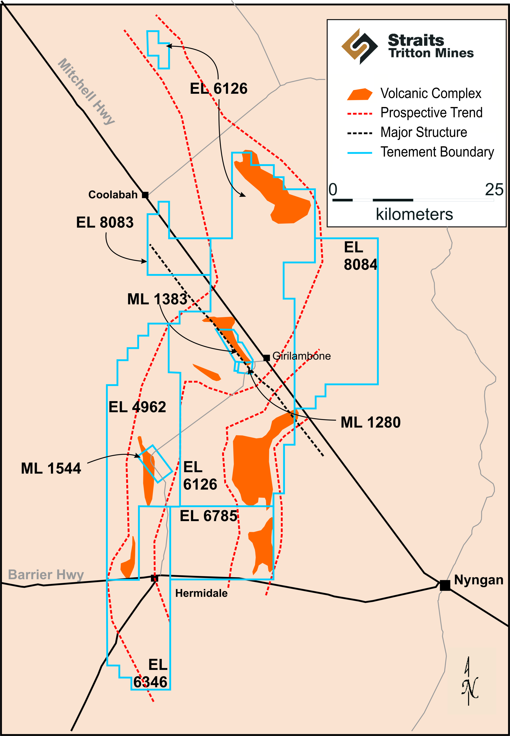
Magnetics
Magnetics highlight basement volcanic complexes and general stratigraphy trends, but always need field validation.
Filtering the data is critical:
RTP, 1VD with correct scaling as first pass.
Filters are critical, as is shown by the two images. Rescaling when going from regional to prospect scale is also critical.
Magnetics is not used to direct detect the sulphide bodies;
It places you on the football field, and then you have to find the goals.

Slide 11
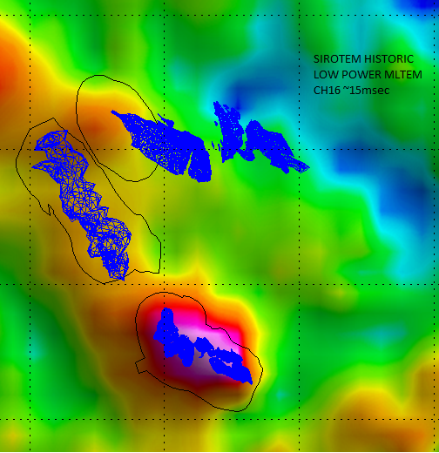
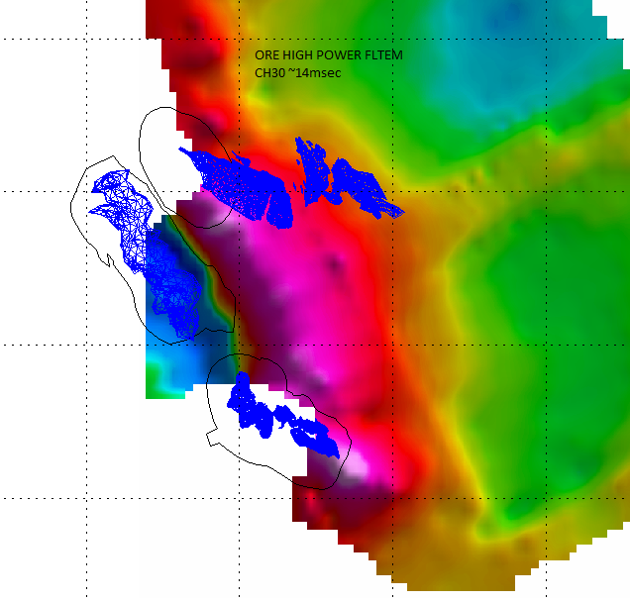
Suface Electromagnetics
SIROTEM Survey 1993
The High Powered FLTEM saw a different depth to the previous SIROTEM MLTEM survey.
HP FLTEM Survey 2015
North East,
Hartmans, &
Larsens Pits
The higher current loop helped, as did tight survey stations, and data stacking, however working around the open cut pits made design more challenging.

Slide 12
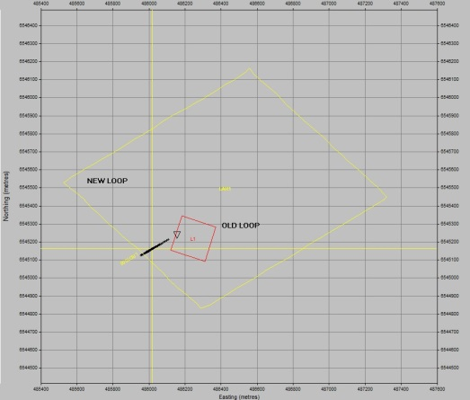
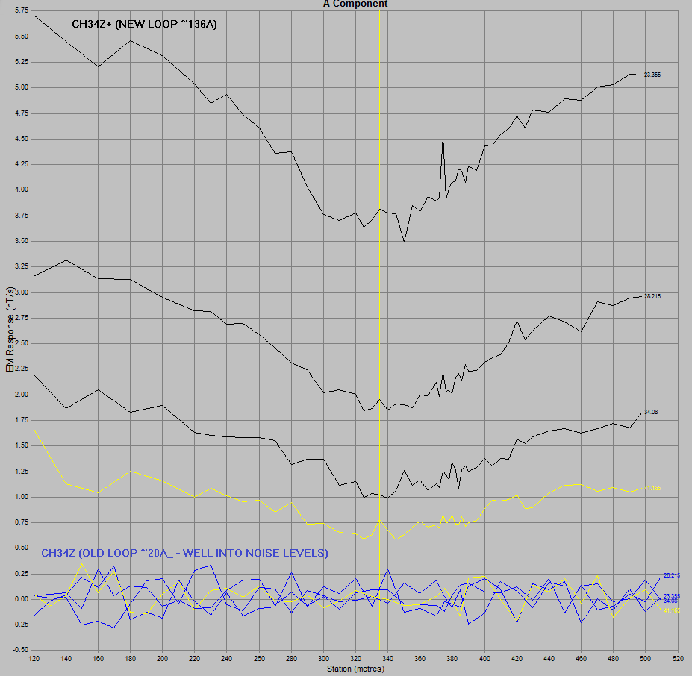
Downhole Electromagnetics
Downhole EM has shown a marked difference between the 20A system (blue lines), and newer high powered ~150A system (black lines). This is in part also due to a larger loop and better coupling angle (shown right).
There is no discernible off hole anomalism with the lower power technique.
Downhole EM Comparison images

Slide 13
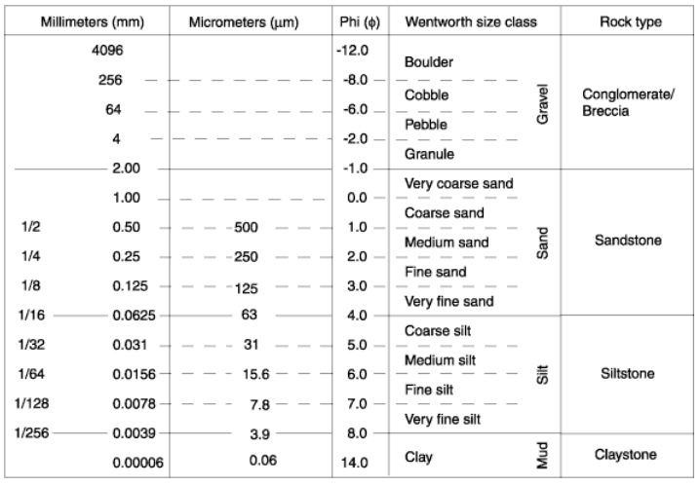
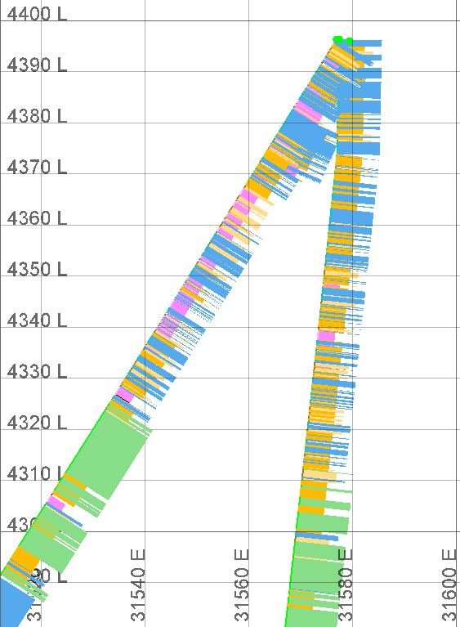
Stratigraphy Correlation
Numerically log sediments based on Udden Wentworth grainsize classification
Detailed logging (sub 1m) intervals
Identify and correlate sedimentary packages between holes
1
2
3
4
5
Application of logging method adapted from Rod Boucher (Linex)
Notes:
Green intervals on image are mafic sequences awarded a numerical value of 6.

Slide 14
Case Examples
Avoca Tank
Girilambone North
14

Slide 15
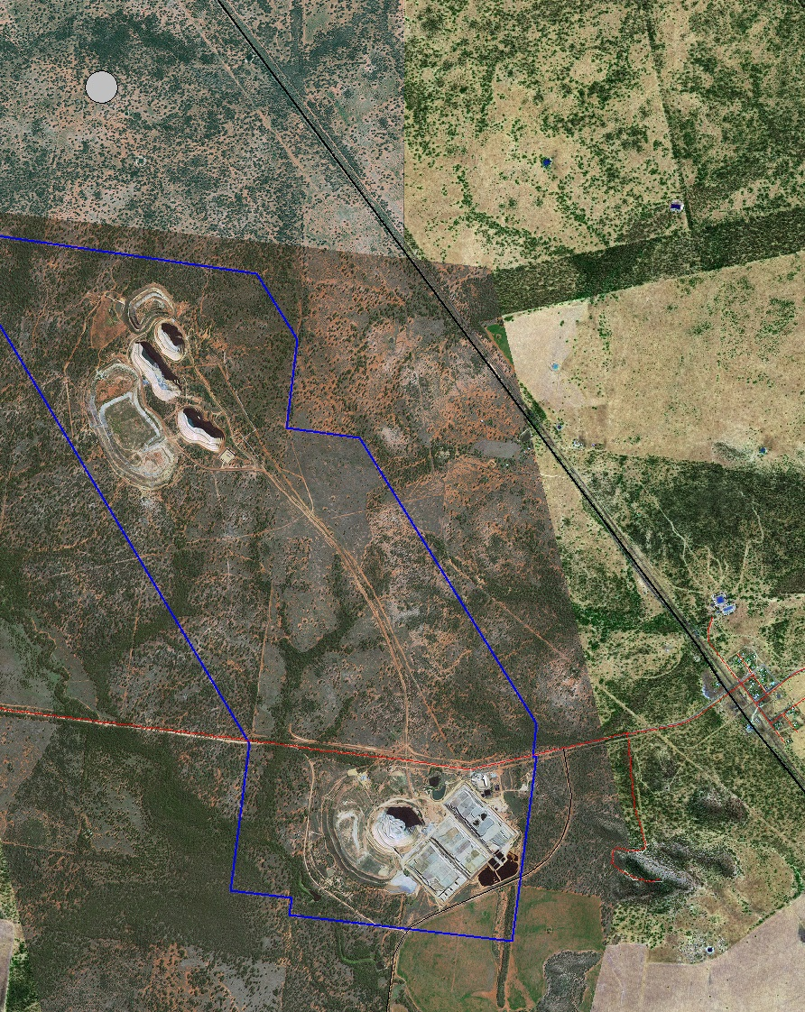
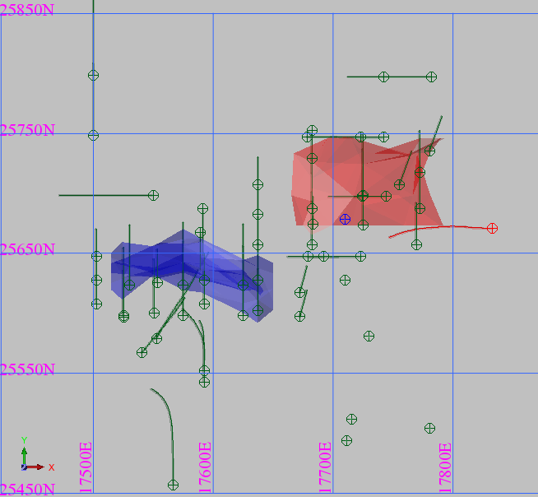
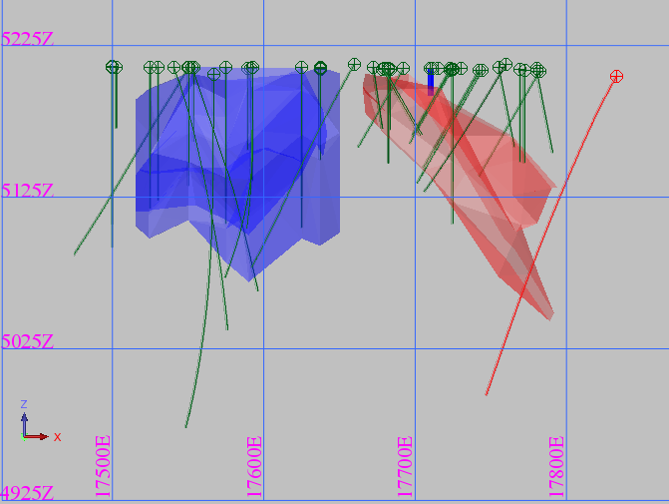
Avoca Tank
Avoca Tank Plan
Avoca Tank area, with drilling up until 2011. 1998 resource in Blue.
One deep RC hole
(ATRC016 – Red Trace) with 6m @ 0.6% Cu.
East-West mineralisation (Blue
Avoca Tank
~2km
Girilambone North
Operations
solid) initially looked more prospective.
After the sulphide intersection in hole 16, the red solid held more potential
Girilambone
Town
Avoca Tank E-W Section
Murrawombie
Mine

Slide 16
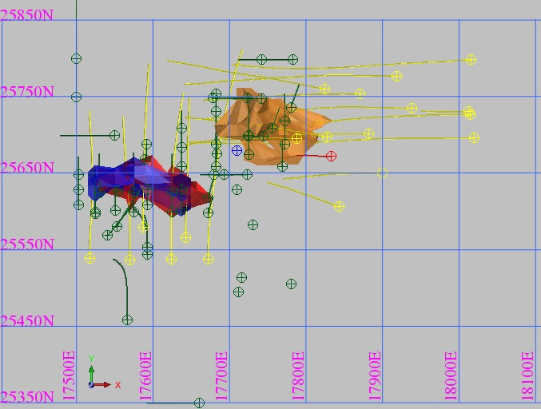
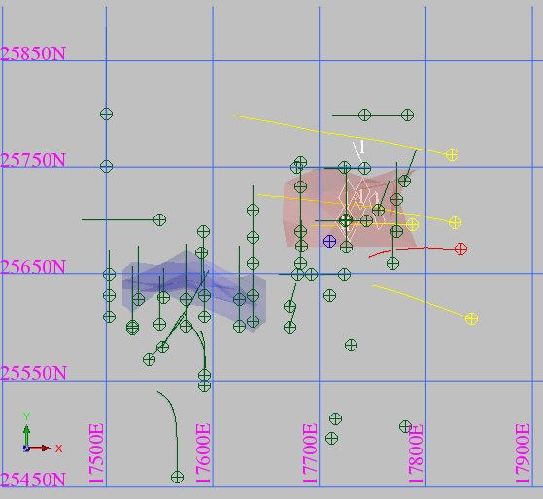
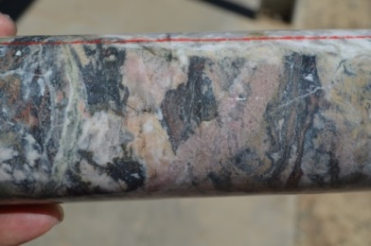
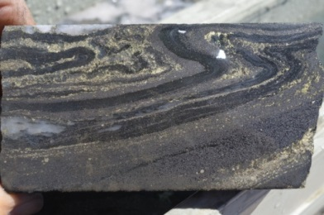
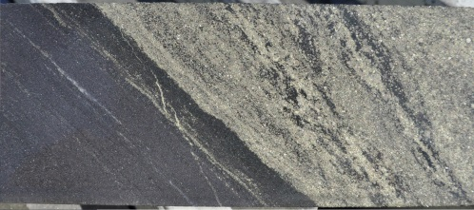
Avoca Tank
The first four holes were testing around ATRC016 intersection and resulted in significant zones of mineralisation.
Phase 2
Phase 1
Holes:
TATD002
TATD003
TATD001
DHTEM Plates
TATD004
Phase 2 drilling defined an Inferred sulphide resource at Avoca Tank (brown solid) and tested depth extension below the previous oxide resource (blue & red solids).
Characteristic HW
alteration,
Locally deformed, and sharp contacts.

Slide 17
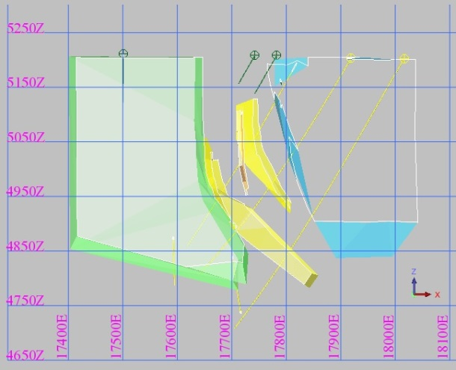
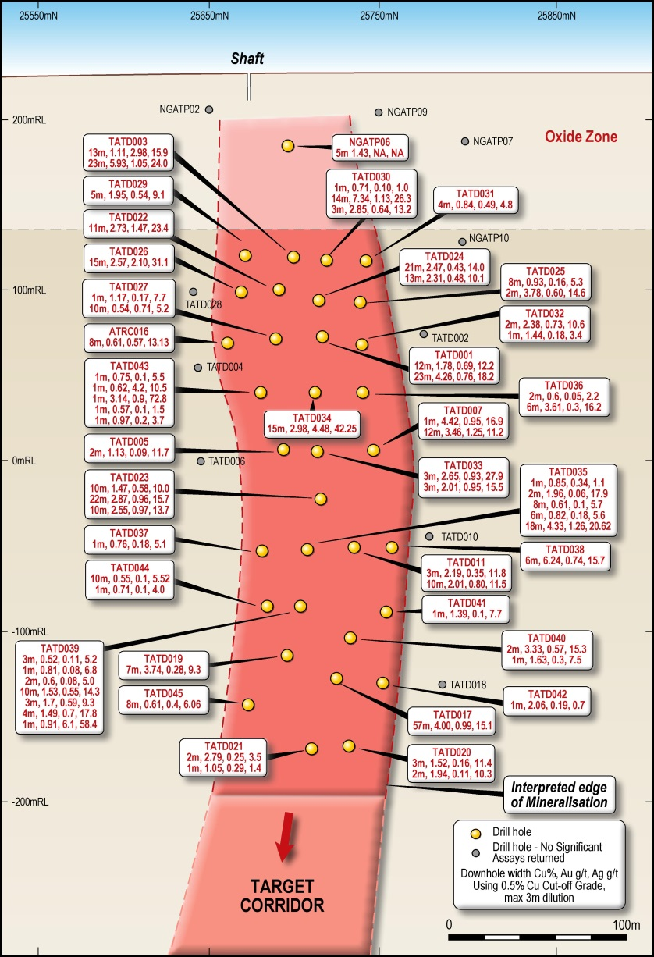
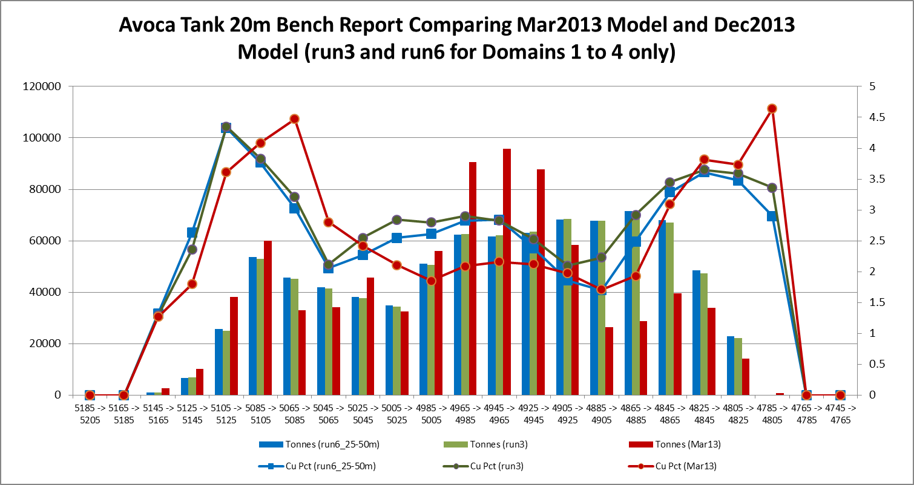
Avoca Tank
General Stratigraphy
Avoca Tank Schematic Longsection
The major units hold together well, to demonstrate the package within which mineralisation sits.
Phase three drilling defined the resource to approximately 400m below surface. Three main lenses which vary in thickness, together form the mineralised horizon.
Sandstone
HW
Mafic
FW

Slide 18
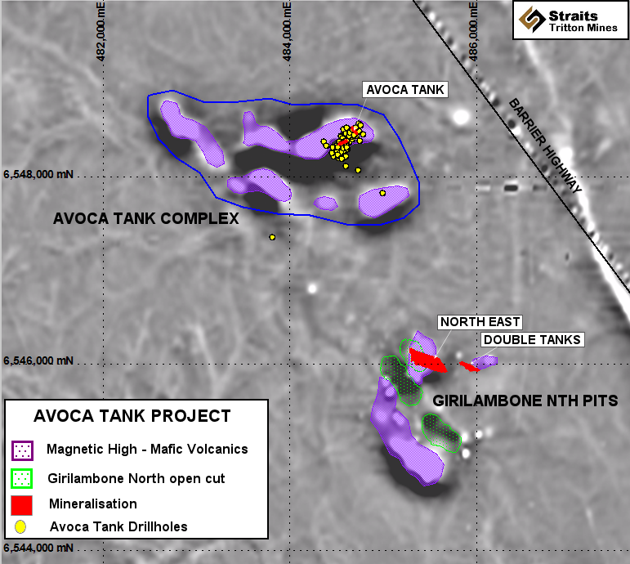
Avoca Tank Summary
The pre-feasibility statement has been completed with:
Ore Reserve: 680kt @ 2.5% Cu*
Mineral Resource: 903kt @ 2.6% Cu*
*as at 30 June 2014
Higher Grade deposit, more analogous to Larsens type mineralisation.
Huge potential for further discovery within the magnetic complex, remaining largely un-tested.
Notes:
Not sure about this slide…. Or a Resources / Challenges slide at the end.

Slide 19
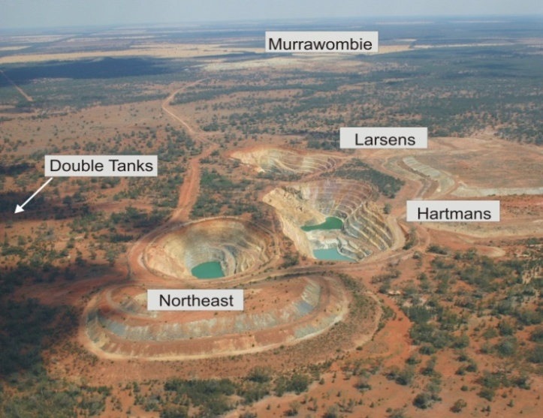
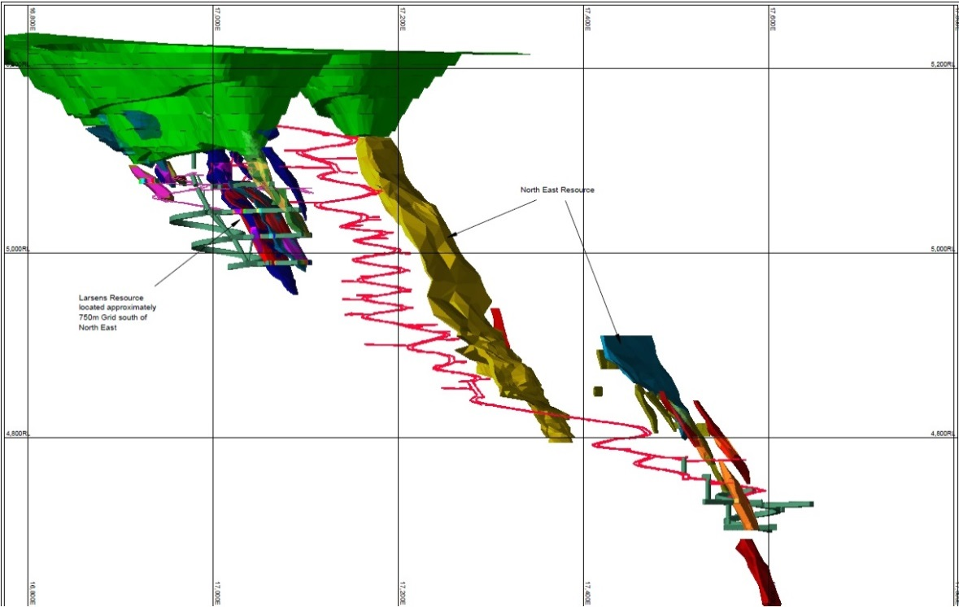
Girilambone North
Girilambone North is the general area surrounding the mining fronts at North East and Larsens.
Exploration is a combination of both work from underground, and from surface.
Good geological control due to mine scale mapping.
SIROTEM completed in 1993
FLTEM survey completed 2015
DHTEM completed on many surface drill holes from 2006 onwards.
Large fault offset is present at North East, discovered 2011, extending mine life ~3yrs.
Double Tanks defined, currently not feasible.
The small deposits are important in maintaining the long term production profile.

Slide 20
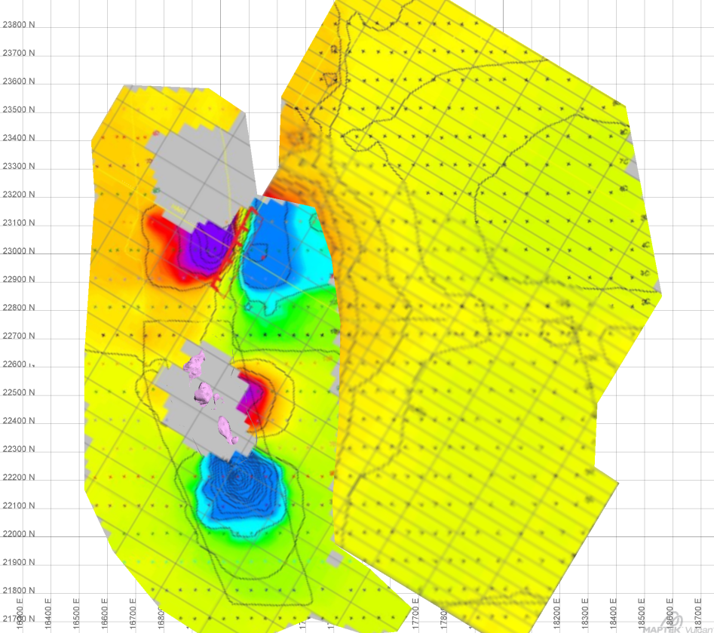
Girilambone North
Detailed stratigraphy logging of holes drilled between North East and Larsen’s mines, indicate they are on the same stratigraphic horizon.
Hartmans is footwall to North East, and there is potential for repeats footwall to Larsens.
FLTEM & DHTEM surveys completed 2015:
Off hole conductor from DHTEM,
Potential strike continuity from FLTEM,
FLTEM did not identify the DHTEM conductor.
Hartmans Deposit
Offsetting
Fault
Potential?
North East Deposit
Potential?
Larsens Deposit
DHTEM Anomalism
Sand dominated
sequence

Slide 21
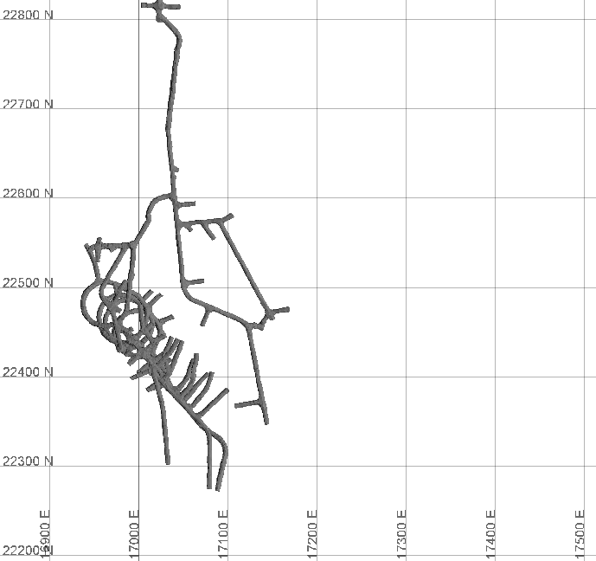
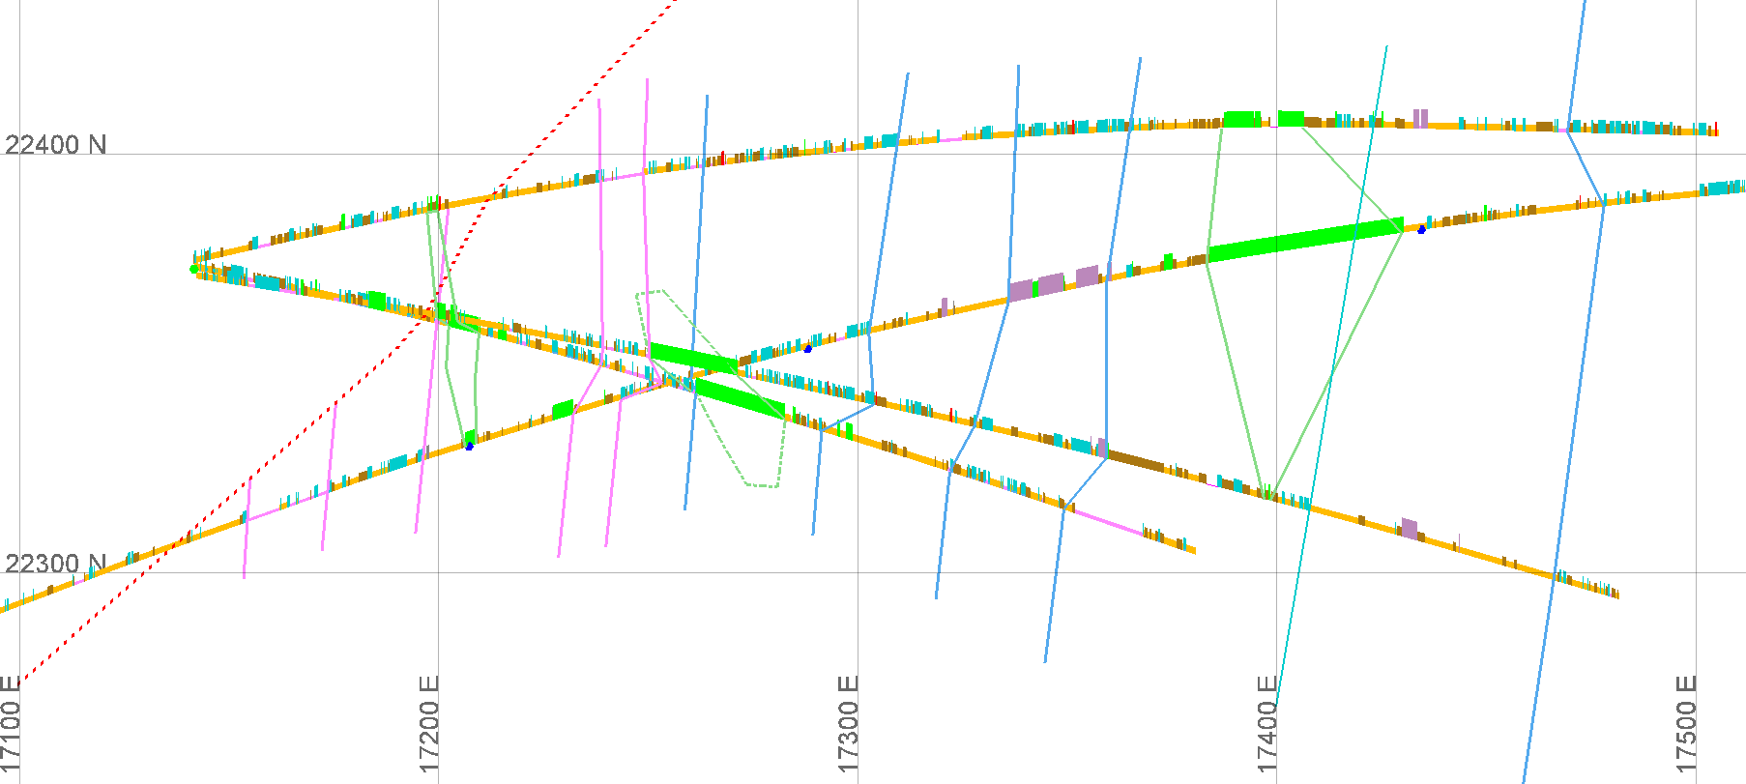
Girilambone North
Work has been focused on an area that has previously been left untested by drilling.
Drilling has allowed correlation of stratigraphy that appears analogous to Larsens, albeit fault offset.
Initially targeting the DHTEM conductor east of Larsens, then refining the target by understanding stratigraphy;
Drilling has confirmed the presence of a new sulphide system, which was blind to surface EM.
This exploration process of discovery is not new, however the newer technologies are making it more effective, and allowing discoveries like this one at Girilambone North to be possible.
Fine sand
Fine sand
Fine sand
Shale
Shale
Shale
Medium sand

Slide 22
Concluding Remarks

Slide 23
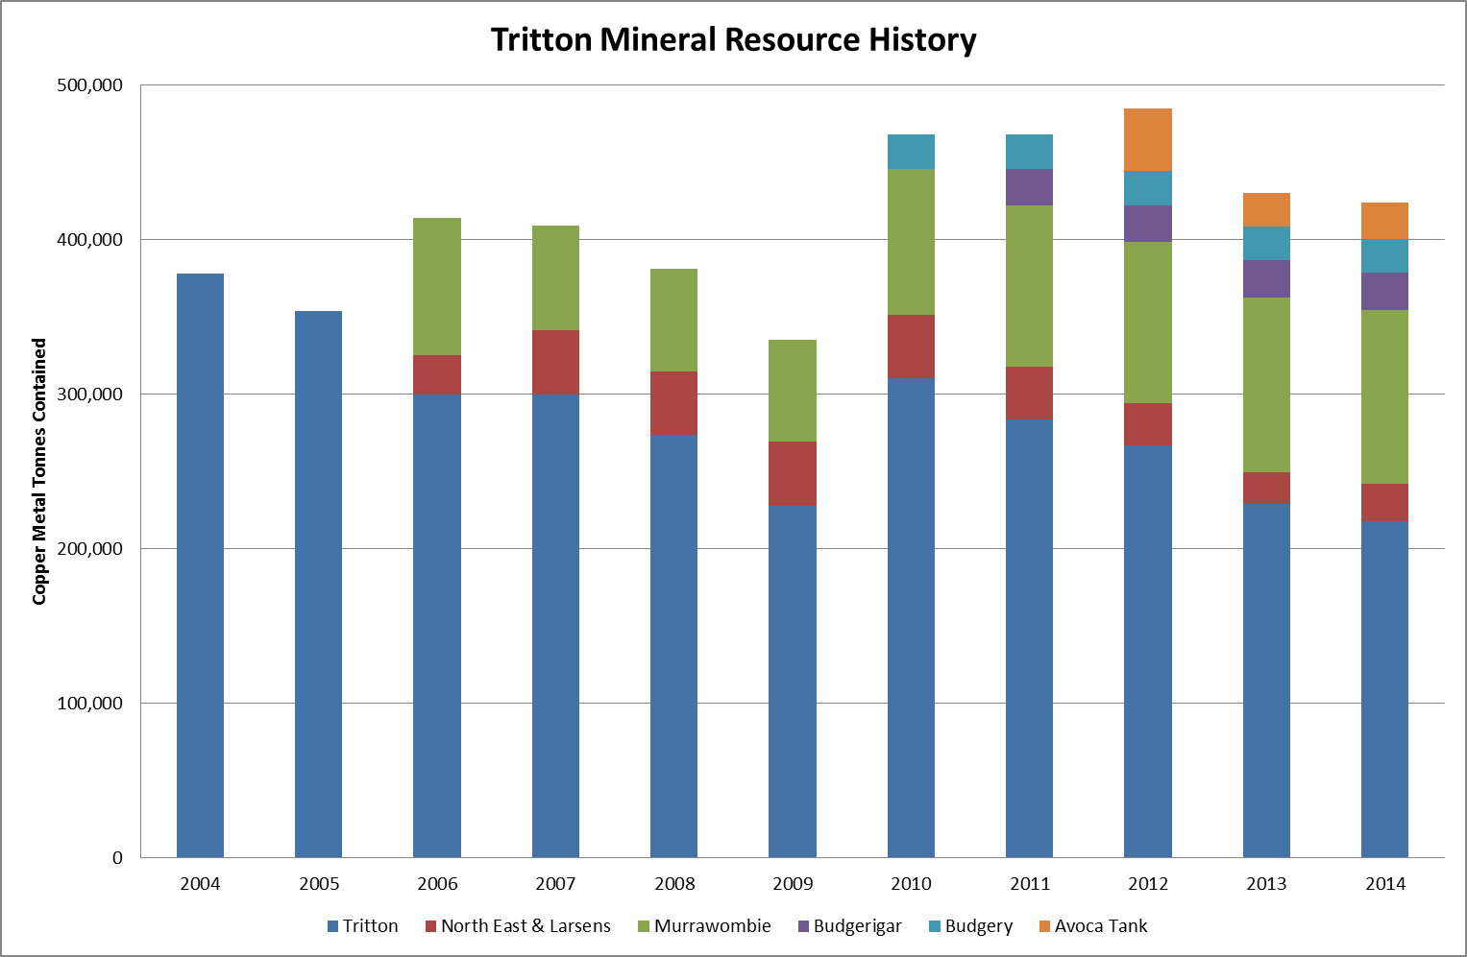
Summary
Relatively short history of exploration specifically focused on sulphide systems;
Geochemistry, Geophysics & Geology all need to work symbiotically for new discovery;
Higher Powered EM has the potential to discover deeper or more subtle bodies than previous technique;
Detailed stratigraphic logging has the potential to correlate very subtle marker units and refine drill targeting;
The current exploration processes used by Straits, whilst being continually refined, are proving successful; resulting in new discoveries, including those at Girilambone North and Avoca Tank, and a healthy Resource inventory for the future.

Slide 24
Acknowledgments
Straits Resources Limited
Brad Cox – Geology Manager
Outer-Rim Exploration
Geopotential Consulting
Russell Mortimer – Geophysicist
Arctan Services P/L
Phil Jones & Associates
NSW Geological Survey
Geoscience Australia
Former employees of Straits Tritton Mines, and the preceding title holders, without who’s work we would not be where we are today.
All of Straits Tritton Mines, Exploration, and Mining Geology team for their continued hard work.

Slide 25
Questions?

